Slide 1
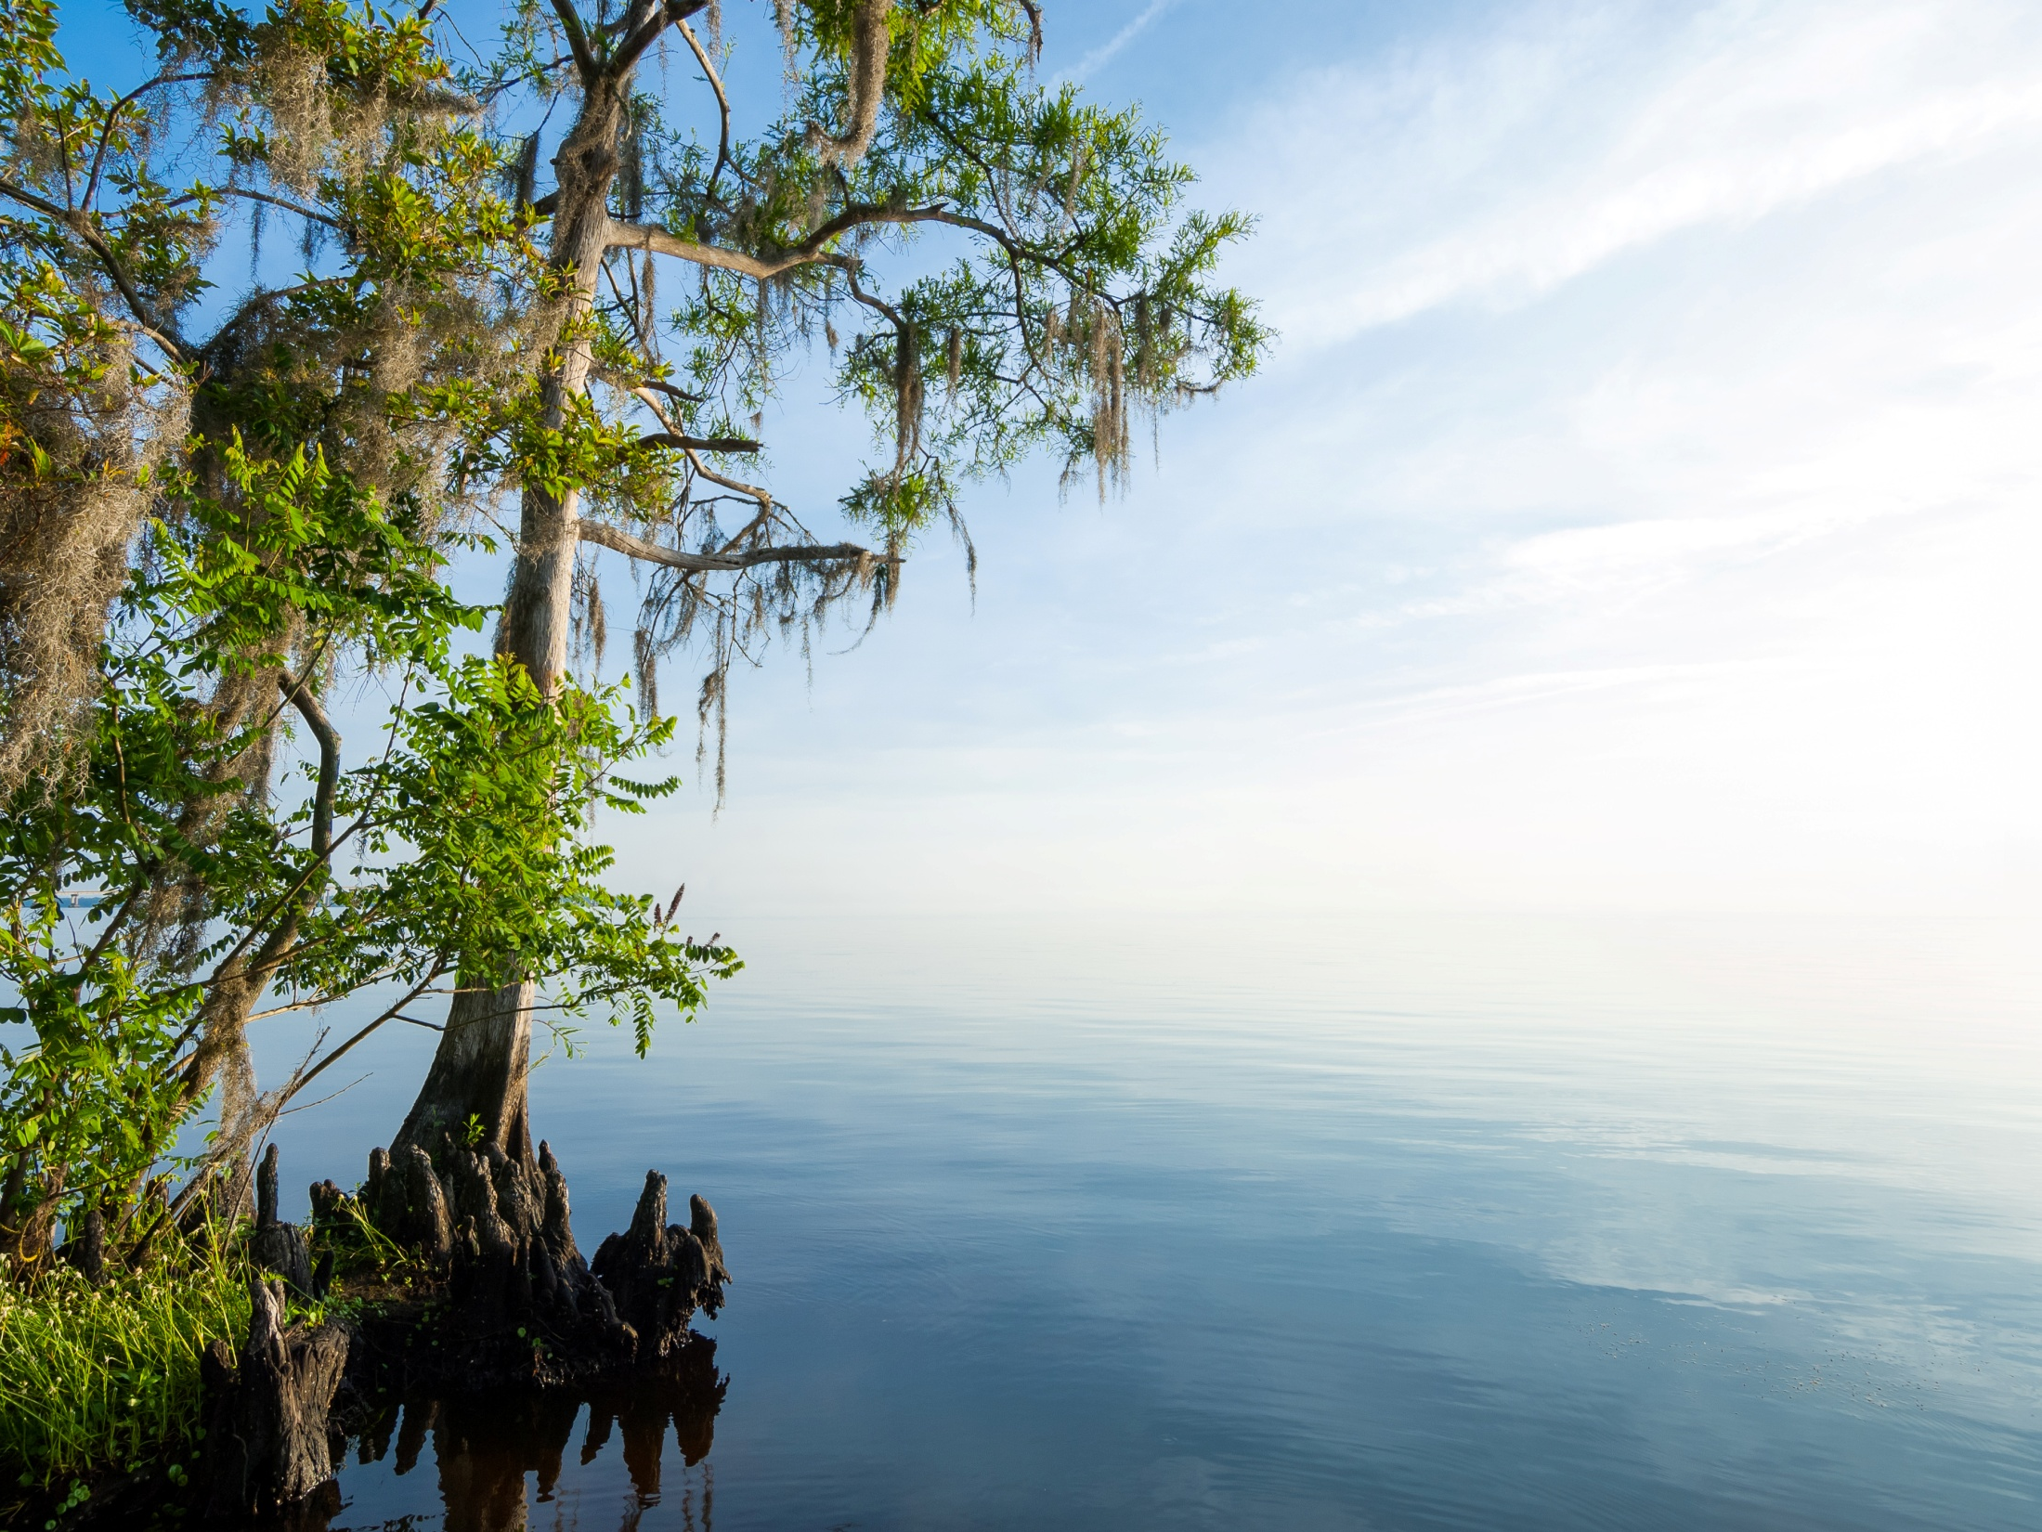
St. Johns River Water Management District
Special Publication SJ97-SP8
Water Management Alternatives:
Effects on Lake Levels and Wetlands
in the Orange Creek Basin
G. B. “Sonny” Hall, Ph.D.
Bureau of Environmental Sciences

Slide 2
The Problem
Man-made alterations within Orange Creek Basin (OCB) changed natural hydrology (flows and water levels)
Resulted in ecological degradation:
  Stabilization of water levels through construction of weirs
  Excessive growth of nuisance aquatic plants
  Water quality degradation
  Increased accumulation of sediments
  Declines in recreational fishing
2

Slide 3
The Study
In response to these issues, SJRWMD completed a mid-1990s study to evaluate ecological value of alternative surface water management strategies
Study objectives:
Develop alternative water management strategies
Develop biohydrologic criteria to assess restoration and conservation potential of strategies
Identify which strategies require more specialized study (e.g., geologic, ecologic, or economic studies)
3

Slide 4
Biohydrologic Criteria Development
Lake and wetland ecosystems require a range of surface water fluctuations for conservation
This range of water levels constitutes a fluctuation regime that consists of:
    High water levels due to temporary and seasonal floods
    Average (middle) water level
    Low water levels that coincide with mild droughts and infrequent extensive droughts
Water management options can increase or decrease range of lake water level fluctuations
4

Slide 5
Biohydrologic Criteria Development
Five biohydrologic criteria were created to accommodate a range of surface water fluctuations
Criteria :
  Infrequent High
  Frequent High
  Middle
  Frequent Low
  Infrequent Low water levels
Criteria define hydrologic conditions required to preserve lake & floodplain wetland ecological processes
5

Slide 6
Biohydrologic Criteria Development
Infrequent High Water Level
  A high water condition - occurs on average once every 5 years for a duration of 30 consecutive days (1:5 years, 30 days).
  Objectives:
  Inundate the entire floodplain wetlands - prevent encroachment of upland species
  Facilitate seed dispersal
  Transport organic matter between floodplain wetlands and lake
  To provide spawning, refugia, and foraging habitat for fish
6

Slide 7
Biohydrologic Criteria Development
Frequent High Water Level
  A high water condition - occurs on average once every 2 years for a duration of 60 consecutive days (1:2 years, 60 days).
  Objectives:
  Maintain lower swamp and shallow marsh habitats
  Transport organic matter between floodplain wetlands and lake
  Provide spawning areas and refugia for small forage fish
  Provide foraging areas for other aquatic organisms, e.g., gamefish
  Facilitate seed dispersal
7

Slide 8
Biohydrologic Criteria Development
Middle Water Level
  A low water condition - occurs on average once every 2 years for a duration of 180 consecutive days (1:2 years, 180 days).
  Objectives:
  Maintain wetland soils by preventing oxidation and subsidence
  Exclude colonization by terrestrial plants
  Maintain sufficient water depth in lake littoral zone for aquatic wildlife
8

Slide 9
Biohydrologic Criteria Development
Frequent Low Water Level
  A low water condition - occurs on average once every 5 years for a duration of 180 consecutive days (1:5 years, 180 days).
  Objectives:
  Rejuvenate lake floodplain and littoral zone by allowing seed germination and growth of wetland plant species
  Increase rate of decomposition of organic sediments, allowing aerobic microbial breakdown
9

Slide 10
Biohydrologic Criteria Development
Infrequent Low Water Level
  A low water condition - occurs on average once every 50 years for a duration of 360 consecutive days (1:50 years, 360 days).
  Objectives:
  Consolidate and compact organic sediments in fish spawning habitat
  Rejuvenate lake floodplain wetlands and upper littoral zone by allowing seed germination and growth
10

Slide 11
Biohydrologic Criteria Development
Surface water levels generated by the SSARR model for water management alternatives plotted against the elevations of major plant community ecotones at Newnans Lake
wetter
wetter
11

Slide 12
Biohydrologic Criteria Development
Other criteria were assessed:
Range of surface water fluctuation
Wetland extent
Change in boater access at 56 ft
12

Slide 13
Ecological Evaluation of Water Management Scenarios
Twenty-three alternative surface water management strategies were evaluated
13

Slide 14
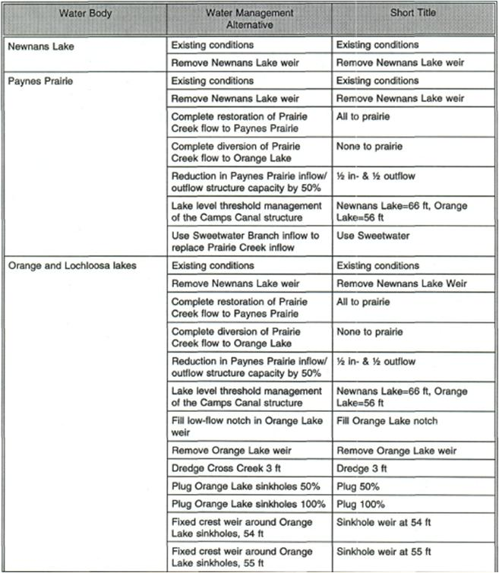
Ecological Evaluation of Water Management Scenarios
14

Slide 15
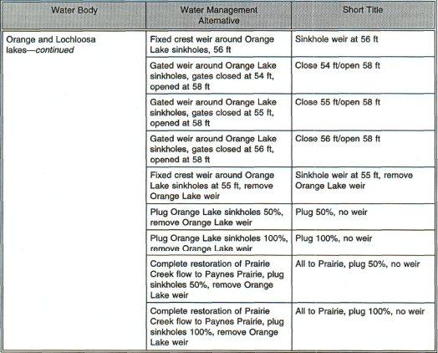
Ecological Evaluation of Water Management Scenarios
15

Slide 16
Ecological Evaluation of Water Management Scenarios

Slide 17
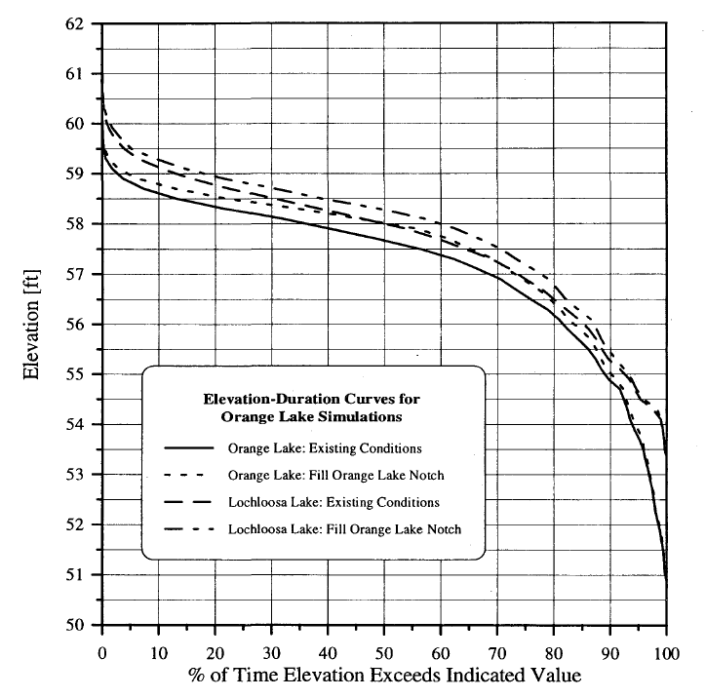
Ecological Evaluation of Water Management Scenarios

Slide 18
Ecological Evaluation of Water Management Scenarios

Slide 19
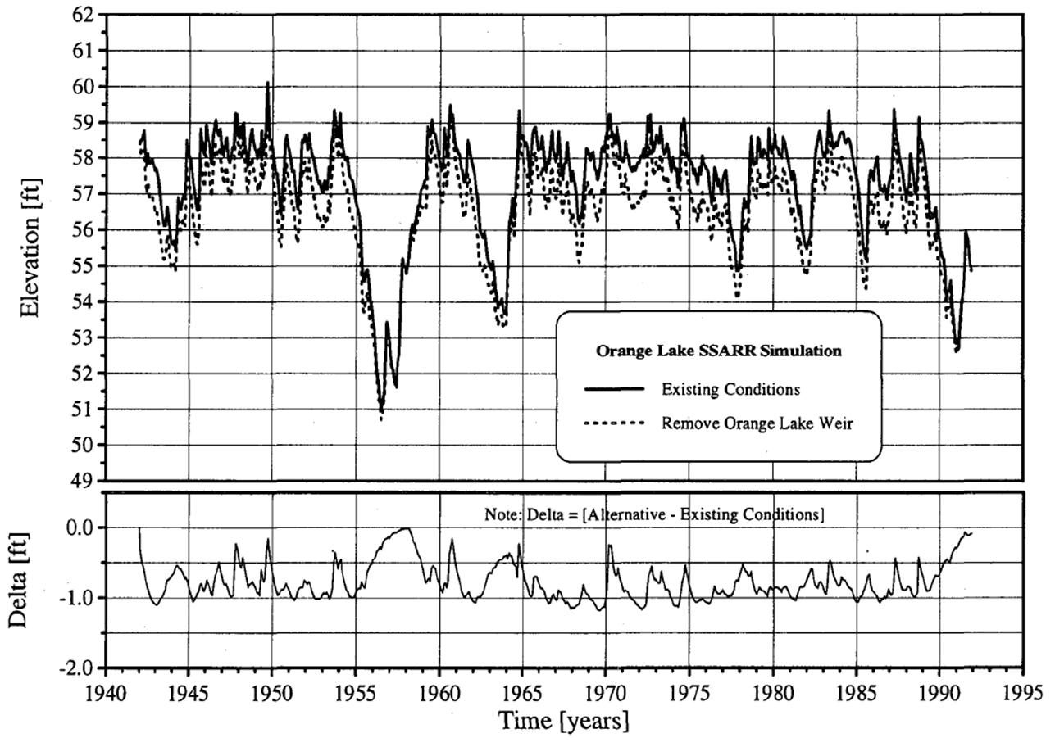
Ecological Evaluation of Water Management Scenarios
19

Slide 20
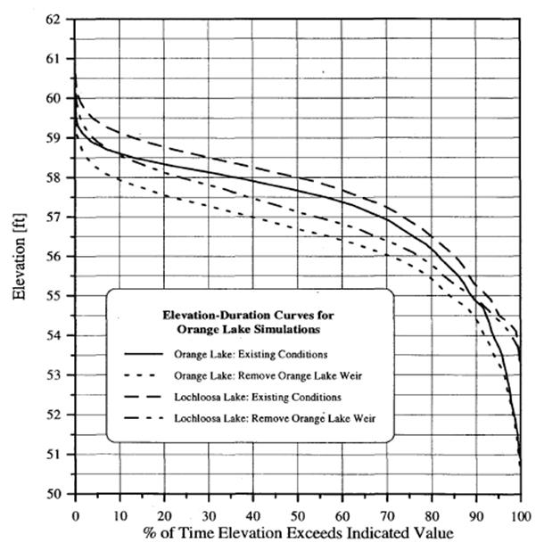
Ecological Evaluation of Water Management Scenarios
20

Slide 21
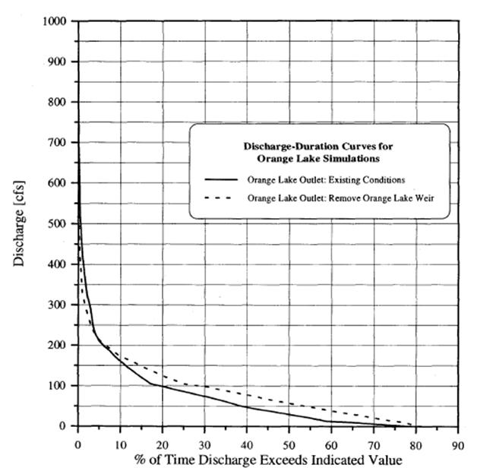
Ecological Evaluation of Water Management Scenarios
21

Slide 22
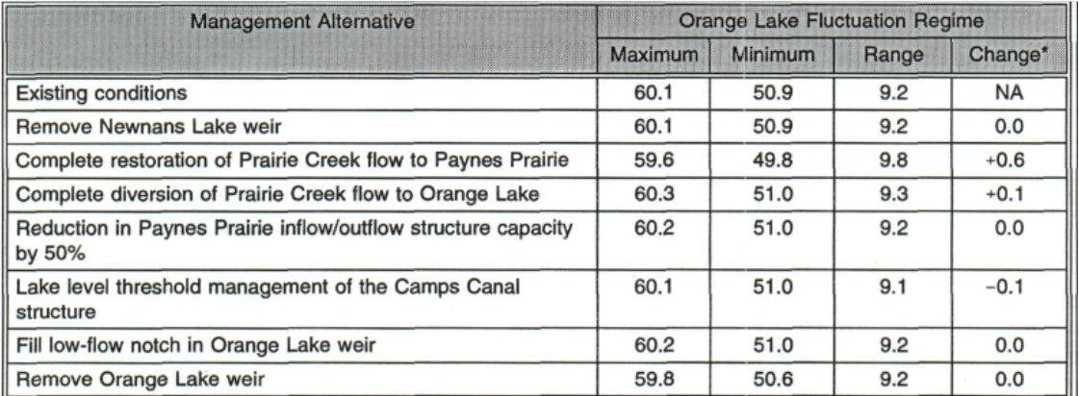
Ecological Evaluation of Water Management Scenarios
Effects of different water management alternatives on the Orange Lake fluctuation regime (ft NGVD)
22

Slide 23
Ecological Evaluation of Water Management Scenarios
Results of Biohydrologic Criteria Assessment at Orange Lake
23

Slide 24
Surface water levels generated by the SSARR model for water management alternatives plotted against the elevations of major plant community ecotones at Orange Lake
24

Slide 25
Ecological Evaluation of Water Management Scenarios
Assessed effects of management strategies on wetland extent
Utilized stage-duration and stage-area curves
25

Slide 26
Ecological Evaluation of Water Management Scenarios
58.6
54.8
Extent of wetlands
26

Slide 27
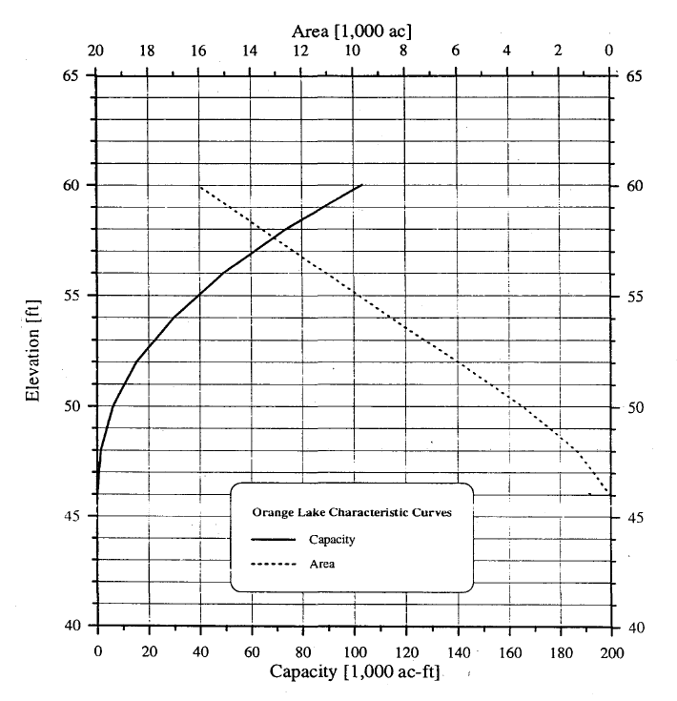
Ecological Evaluation of Water Management Scenarios
58.6
54.8

Slide 28
Ecological Evaluation of Water Management Scenarios
Change in acreage for Orange and Lochloosa lakes wetlands for various water management alternatives
28

Slide 29
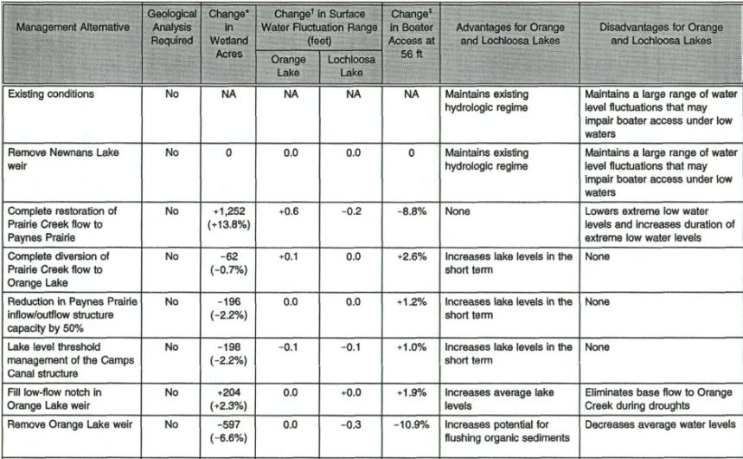
Ecological Evaluation of Water Management Scenarios
Summary of wetland and hydrologic effects of surface water management alternatives for Orange and Lochloosa lakes
29

Slide 30
Questions
30

