Slide 1

St. Johns River Water Management District
Hydrologic Modeling in
Orange Creek Basin
Dale Smith, P.E.
Bureau of Engineering & Hydro - Sciences

Slide 2
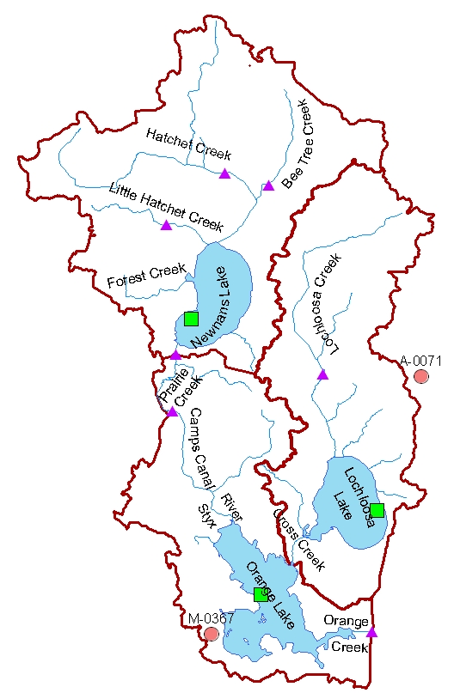
Orange Creek Basin
  Covers 600 Square Miles
  282 Square Miles contribute to Orange Lake
Man-made Alterations
  Railroad Trestle
  US 301
  Newnans Lake Weir
  Prairie Creek Water Control Structure
  Orange Creek Weir
  Lochloosa Lake Outlet
  Sinkhole Intervention

Slide 3
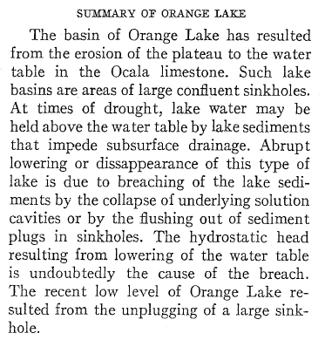

Slide 4
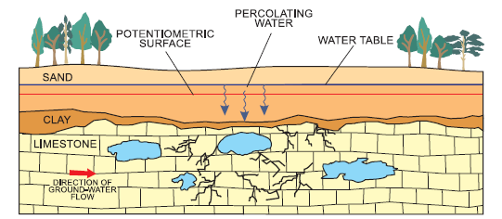
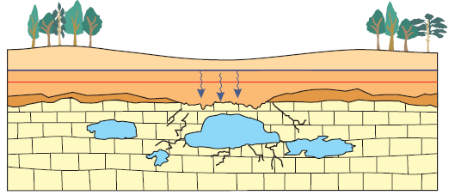
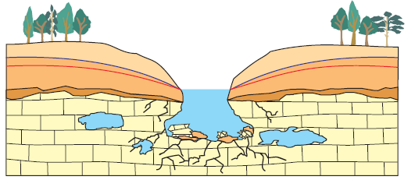
Surficial aquifer
Confining unit
Floridan aquifer
Source: Schiffer (1998)
Formation of Florida Lakes

Slide 5
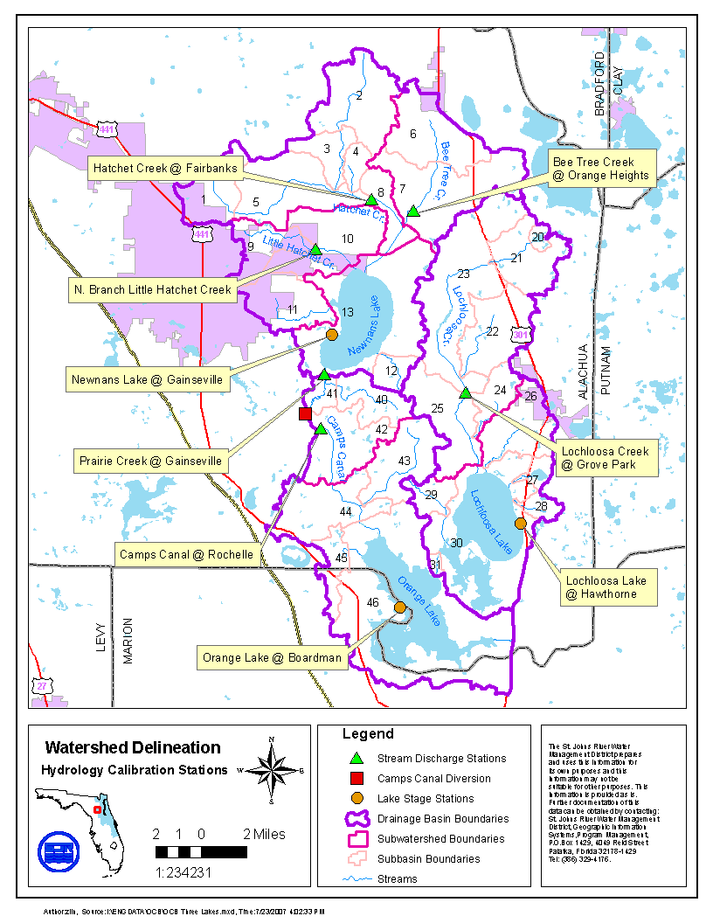
Why Model ?
The watershed has plenty of data that can be used to provide linkages to past events.
Data alone will not help predict changes in a watershed.
Models are need to generate data necessary to analyze scenarios.

Slide 6
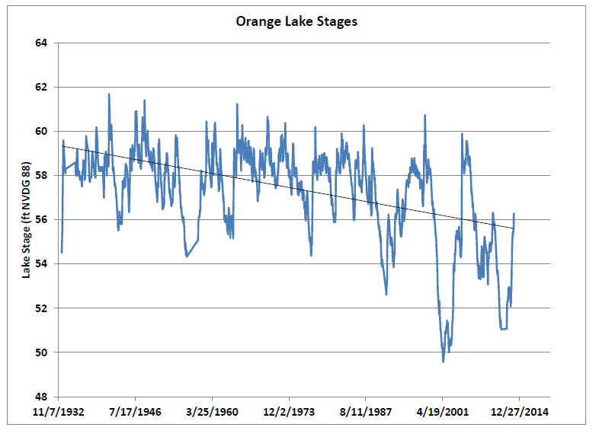
Orange Lake Water Levels

Slide 7
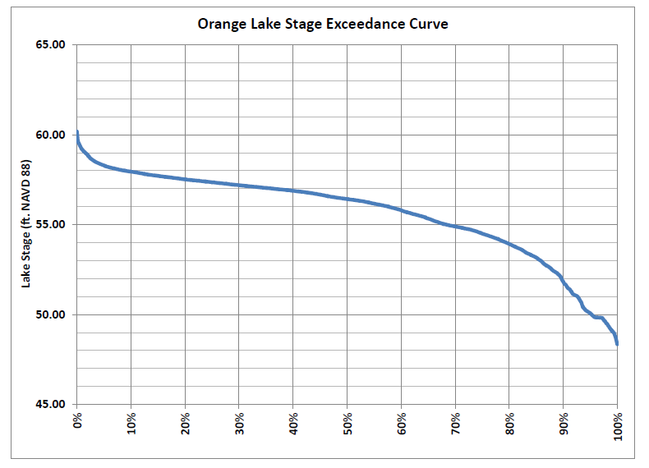
Orange Lake Water Levels

Slide 9
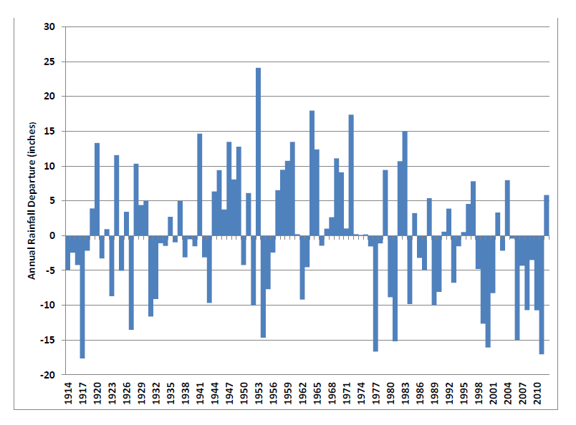
Regional Rainfall Patterns

Slide 10
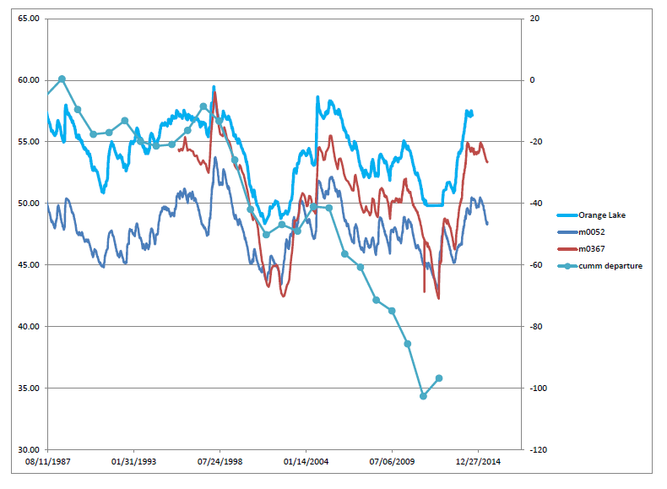
Orange Lake vs. Aquifer Water Levels

Slide 11
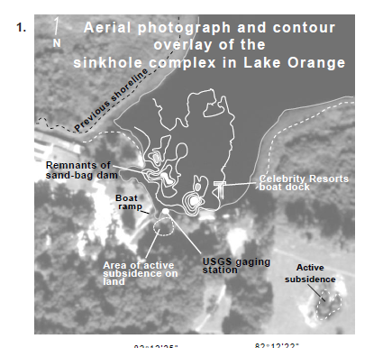
Orange Lake Sinkhole Complex

Slide 12
Models Developed in the Orange Creek Basin
1997 SSARR Model for Alternative Analysis of Lake Levels
2006 Spread sheet models for PLRGs
HSPF Model for TMDLs
HSPF Model for the Water Supply Impact Study
2014 HSPF model of Lockloosa Lake for TMDL

Slide 13
Model Inputs
Precipitation
Evaporation
Discharge
Stages
Watershed delineations
Land use
Discharge/ Recharge

Slide 14
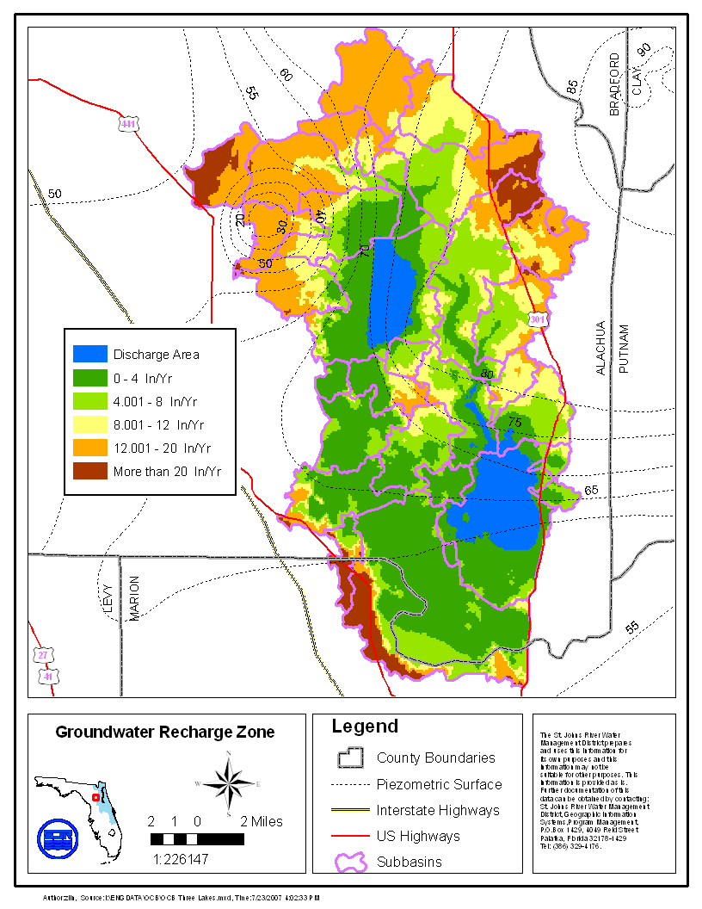
Orange Creek Basin Groundwater Recharge Zones

Slide 15
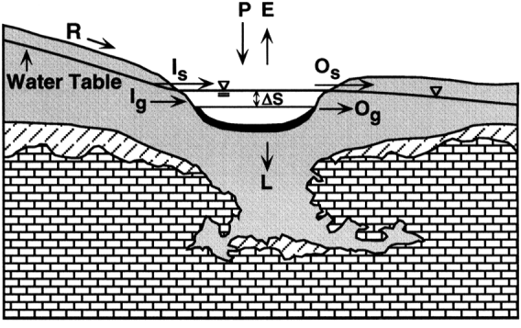
Modeling Vertical Leakage (L)
Between Lake and Underlying Aquifer
Conceptually,
Practically, in HSPF model a Special Action module written to model L.
Source: Motz et al. (2001)

Slide 16
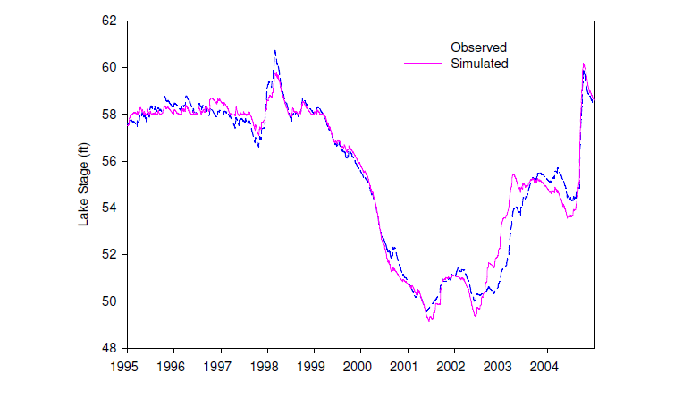
Orange Lake Model Calibration

Slide 17
Orange Lake Water Budget
Inflow
Outflow

