Slide 1

FY12 and FY13 Budget Development
Special Board Meeting
Alachua County
Office of Management and Budget
May 26, 2011

Slide 2
FY12 Budget Development
Fiscal Updates

Slide 3
FY12 Budget Development
Budget Meeting Calendar Review

Slide 4

FY12 Budget Development
Calendar Review
  FY12 Budget Development Calendar
    Budget development calendar has been approved and posted to the internet
    Special Board meetings March thru June
      Next budget meeting is June 7 and will include an overview of budget submissions from Constitutional and Judicial Offices. There will also be a discussion on the proposed FY12 thru FY16 CIP.

Slide 5
FY12 Budget Development
Calendar Review
  FY12 Budget Development Calendar
    Tentative Budget presentation scheduled for July 7
      Set proposed millage rates at regular Board meeting on July 12
    Special Board meetings August and September
    Public Hearings (TRIM) in September on regular Board meeting dates
      September 13 and 27 will also adopt policies, CIP and Fee Schedule

Slide 6
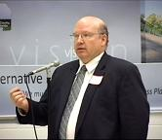
FY12 Budget Development
Calendar Review
  2011 Community Conversations

Slide 7
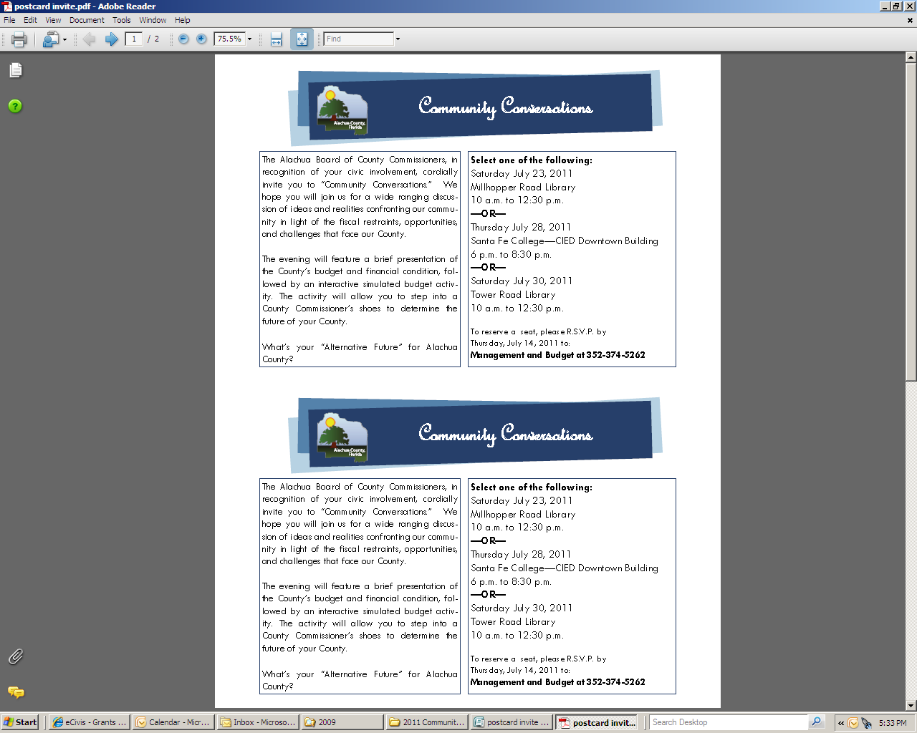
FY12 Budget Development
Calendar Review
  2011 Community Conversations

Slide 8
FY12 Budget Development
Calendar Review
  2011 Community Conversations
    Community meetings will include a discussion on service level expectations
    National Center for Civic Innovation-Center on Government Performance (Trailblazer grant) will cover expenses associated with continuing this program
    Meetings scheduled for July 23, July 28 and July 30 at various locations

Slide 9
FY12 Budget Development
2011 State Legislative Session

Slide 10
FY12 Budget Development
Legislative Session
  State budget is almost $70 billion budget
    $3.8 million reduction includes the elimination of some trust funds and reductions to State health departments
    Property tax reduction comes thru reductions to water management districts
  Governor is expected to sign today
    Anticipated vetoed items could impact grant funding

Slide 11
FY12 Budget Development
Legislative Session
  State Revenue and Expenditure Caps (TABOR like)
    An amendment to the State Constitution
    Requires 60 percent voter approval at the 2012 general election.
    Legislation does not include specific language to directly impact county government revenues or expenditures
      Shared funding formula could change reverting funds back to the State’s budget

Slide 12
FY12 Budget Development
Legislative Session
  Non-Homestead Assessment Cap
    Proposed Constitutional amendment reducing property value assessment cap from 10% to 3%
      Similar to Save Our Homes
    Additional exemption for first-time home buyers.
    Requires 60 percent voter approval at the 2012 general election

Slide 13
FY12 Budget Development
Legislative Session
  Pension Reform Plan
    Impacts State and County governments thru Florida Retirement System (FRS); also proposed to impact other local government retirement plans
    FRS employer contribution rates will decrease as of July 1, 2011
      Current legislation increases rates beginning July 1, 2012

Slide 14
FY12 Budget Development
Legislative Session
  Pension Reform Plan
    FRS requires 3% employee contribution beginning July 1, 2011
    DROP program is retained with a lower interest rate on retirement earnings
    Increased vesting time and retirement age for new FRS members
    Eliminates cost-of-living adjustments for current FRS retirees for 5 years

Slide 15
FY12 Budget Development
Legislative Session
  Pension Reform Plan
    Reduced costs to local government employers can be used to offset employee costs, fund other operating expenses or could reduce resources needed

Slide 16
FY12 Budget Development
Legislative Session

Slide 17
FY12 Budget Development
Fiscal Outlook for Alachua County

Slide 18
Note: Reflects changes in property tax revenue only
Simple majority = new construction value + change in PCPI
Rollback (up) = millage need for same amount of revenue as prior year
Super Majority = 10% over simple majority
Total new construction value estimate of $72,000,000 (General Fund only)
Total new construction value estimate of $50,000,000 (all MSTU’s)
Change in State per capita personal income growth is .55%

Slide 19
FY12 Budget Development
Budget Development Principles

Slide 20
FY12 Budget Development
Budget Principles
  FY11 Budget Development Principles - Governance
    Maintain 5% reserve policy for major operating funds
    Maintain General Fund budget allocation share with Constitutional Offices
    Maintain current funding allocation for Law Enforcement between General Fund and MSTU

Slide 21
FY12 Budget Development
Budget Principles
  FY11 Budget Development Principles – Governance
    One-time sources will be allocated toward reserves or one-time expenditures
    Continue to present a two-year budget
    Budget property tax revenue based on current and simple majority millage rates

Slide 22
FY12 Budget Development
Discussion, Comments, Questions

Slide 23
FY12 and FY13 Budget Development
May 26, 2011

