Slide 1
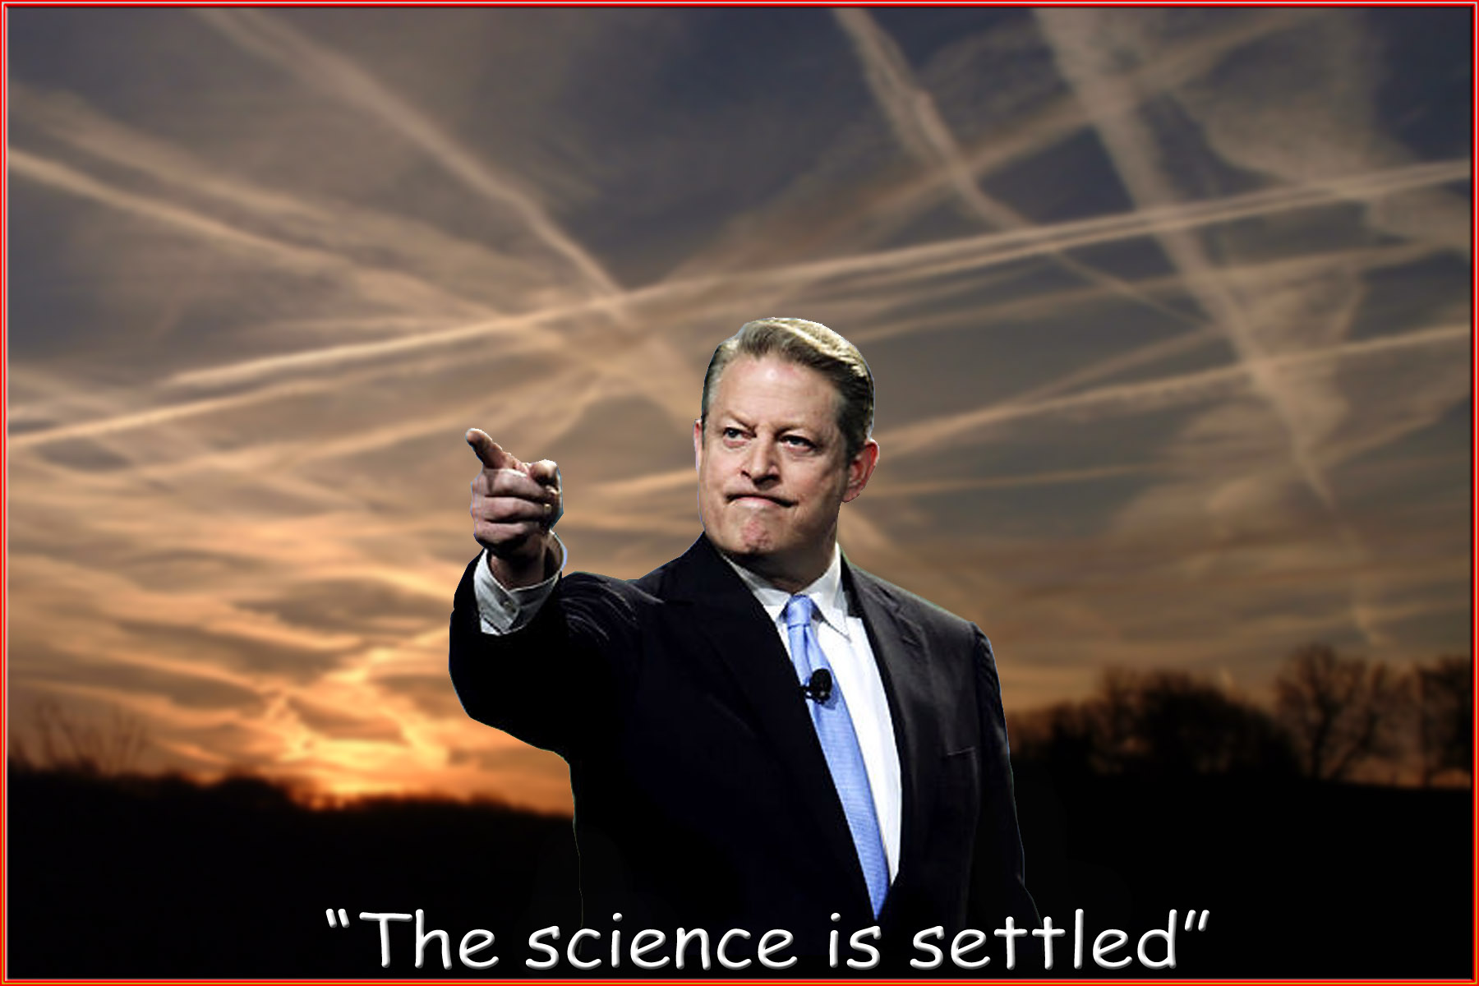
Presentation by EPAC Board member, Harold Saive - July 1, 2014

Slide 2

The purpose of this presentation is to review current Geoengineering and Global Warming mitigation policies and technologies to determine how this issue could limit or enhance the option of Alachua County, Gainesville and local governments to exercise local control, future land use, water resources and/or environmental protection.
Who Will Chose “Winners and Losers” in Geoengineering?
Geoengineering technologies can reduce rainfall and interfere with solar panel energy efficiency
"Greater government intervention in geoengineering research and development may stifle fact gathering and agenda setting, incorrectly choose winners and losers, and unnecessarily circumscribe a science still in its infancy.” – Page 20

Slide 3
Geoengineering
“Geoengineering is the deliberate large-scale intervention in the Earth’s natural systems to
counteract climate change.”
(References to “warming” and “AGW” have been dropped in current definition)
University of Oxford Geoengineering Programme

Slide 4
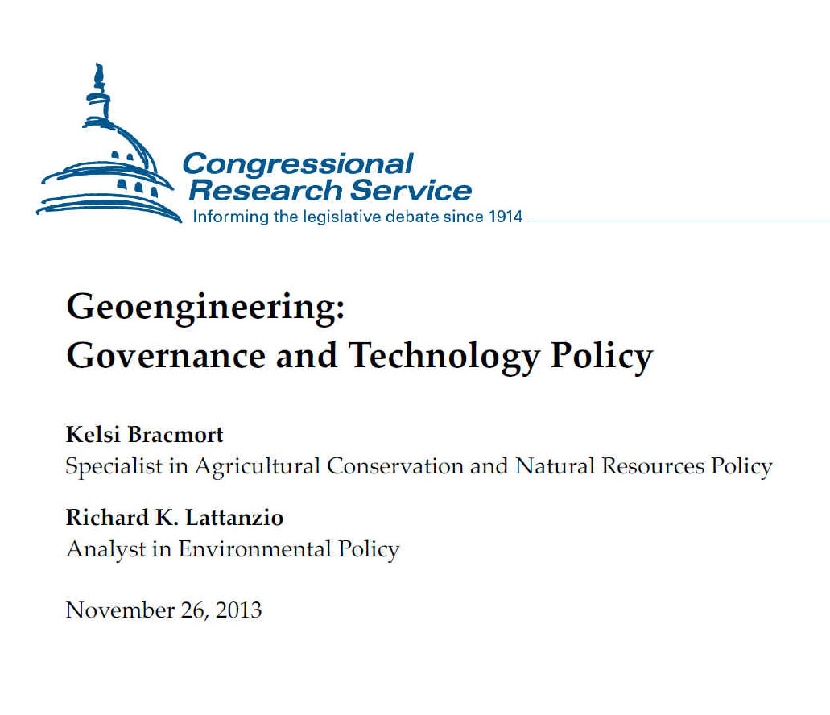
Complete Online PDF Document – Click Here

Slide 5

The Congressional Research Service Report makes frequent reference to the Royal Society’s 2009 publication:
Geoengineering The Climate
Science Governance and Uncertainty
Complete Document – Click here

Slide 6

Climate change policies at both the national and international levels have traditionally focused on measures to mitigate greenhouse gas (GHG) emissions and to adapt to the actual or anticipated impacts of changes in the climate. As a participant in several international agreements on climate change, the United States has joined with other nations to express concern about climate change.
Some recent technological advances and hypotheses, generally referred to as “geoengineering” technologies, have created alternatives to traditional approaches to mitigating climate change.
If deployed, these new technologies could modify the Earth’s climate on a large scale. Moreover, these new technologies may become available to foreign governments and entities in the private sector to use unilaterally—without authorization from the United States government or an international treaty—as was done in the summer of 2012 when an American citizen conducted an ocean fertilization experiment off the coast of Canada.

Slide 7
The term “geoengineering” describes an array of technologies that aim, through large-scale an deliberate modifications of the Earth’s energy balance, to reduce temperatures and counteract anthropogenic climate change.
Most of these technologies are at the conceptual and research stages, and their effectiveness at reducing global temperatures has yet to be proven.
Moreover, very few studies have been published that document the cost, environmental effects, sociopolitical impacts, and legal implications of geoengineering.
If geoengineering technologies were to be deployed, they are expected to have the potential to cause significant transboundary effects.

Slide 8
In general, geoengineering technologies are categorized as either a carbon dioxide removal (CDR) method or a solar radiation management (SRM) method.
CDR methods address the warming effects of greenhouse gases by removing carbon dioxide (CO2) from the atmosphere. CDR methods include ocean fertilization, and carbon capture and sequestration.
SRM methods address climate change by increasing the reflectivity of the Earth’s atmosphere or surface.
Aerosol injection and space-based reflectors are examples of SRM methods. SRM methods do not remove greenhouse gases from the atmosphere, but can be deployed faster with relatively immediate global cooling results compared to CDR methods.

Slide 9
Geoengineering technologies, applied to climate, aim to achieve large-scale and deliberate modifications of the Earth’s energy balance in order to reduce temperatures and counteract anthropogenic (i.e., human-made) climate change; these climate
modifications would not be limited by country boundaries.
As an unproven concept, geoengineering raises substantial environmental and ethical concerns for some observers. Others respond that the uncertainties of geoengineering may only be resolved through further scientific and technical examination.
Proposed geoengineering technologies vary greatly in terms of their technological characteristics and possible consequences. They are generally classified in two main groups:
Solar radiation management (SRM) method: technologies that would increase the
reflectivity, or albedo, of the Earth’s atmosphere or surface, and
Carbon dioxide removal (CDR) method: technologies or practices that would remove CO2 and other GHGs from the atmosphere.

Slide 10
Carbon Dioxide Removal (CDR) methods include:
Afforestation: involves planting tree seedlings on sites that have been without trees for several years, generally a decade or more. (Land use change?)
Ocean fertilization: The addition of nutrients such as iron to the ocean to expedite carbon
sequestration from phytoplankton.
Biomass: In addition to crop-based carbon capture, bioenergy generation coupled with CO2 capture and sequestration (BECS) could sequester carbon. BECS consists of three phases: planting and growing a biomass crop such as switchgrass, harvesting the crop for biofuel production, and capturing and storing the carbon released during this process.
BECS is expected to use technology similar to CCS technology used for capturing CO2 from fossil fuel combustion. When biomass is used to generate electricity, the CO2 released in the process may be sequestered in geologic formations, in the same way as it would be used in a fossil-fuel generation CCS operation.

Slide 11
Geoengineering Governance
Geoengineering technologies aim to modify the Earth’s energy balance in order to reduce
temperatures and counteract anthropogenic climate change through large-scale and deliberate modifications.
Implementation of some of the technologies may be controlled locally, while other
technologies may require global input on implementation.
What risk factors and policy considerations enter into the debate over
geoengineering activities and government oversight?
• At what point, if ever, should there be government oversight of geoengineering
activities?
• If there is government oversight, what form should it take?
• If there is government oversight, who should be responsible for it?
• If there is publicly funded research and development, what should it cover and
which disciplines should be engaged in it?

Slide 12
Public opinion on geoengineering is difficult to gauge at this early stage.
It is likely to both evolve as more information becomes available and vary depending on the particular technology being discussed.
Nevertheless, a 2009 report by the United Kingdom’s Royal Society, which is widely considered to be the first comprehensive analysis of geoengineering technologies, has broadly identified three categories of perspectives held within the scientific community about the deployment of geoengineering technologies:
• Geoengineering is a dangerous manipulation of Earth systems and therefore
intrinsically unethical;
• Geoengineering is strictly an insurance policy against major mitigation failure;
And
• Geoengineering will help buy back time lost during international mitigation
negotiations.

Slide 13
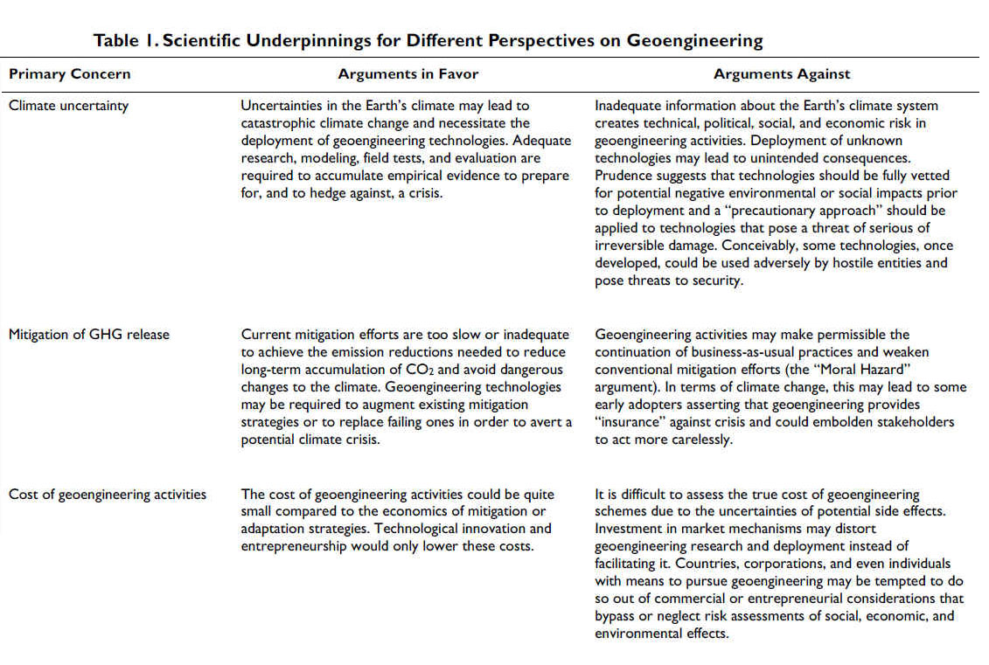
Scientific Underpinnings for Different Perspectives on Geoengineering

Slide 14
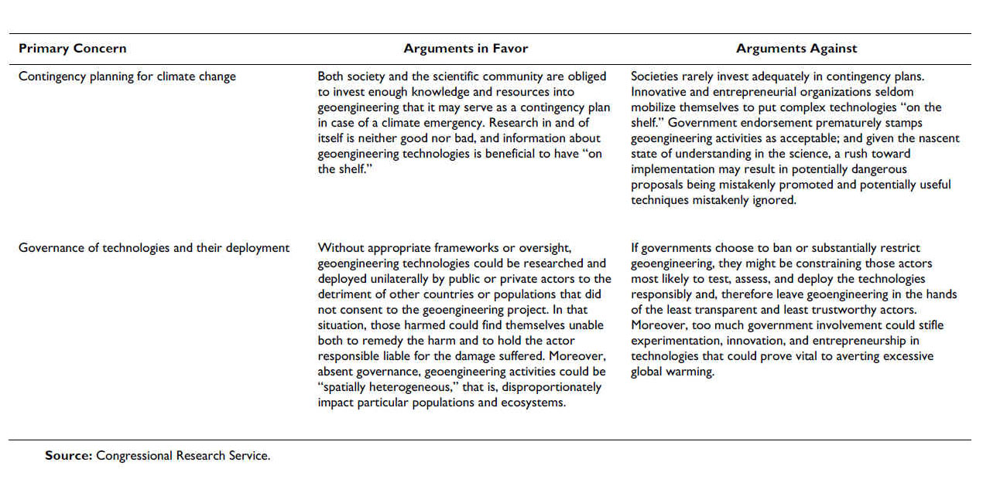
Table 1. Scientific Underpinnings for Different Perspectives on Geoengineering

Slide 15
Geoengineering Technologies
A wide range of geoengineering technologies have been proposed to address climate change.
Geoengineering technologies attempt to mitigate continued warming of the Earth’s climate.
The technologies vary in complexity from planting trees for carbon sequestration to launching mirrors into space for sunlight reflection.
Most of the technologies are not yet proven and are at the theoretical or research phase.
Several of the proposed technologies were recently conceived; if they prove feasible and effective, they would require large amounts of funding for full-scale deployment; and generally they lack political, scientific, and public support.

Slide 16
Carbon Dioxide Removal
While the impacts of CDR methods could take years to realize, many CDR methods could be governed more easily than SRM methods by existing laws.
For example, carbon capture and storage from a biomass power plant could be subject to the same environmental and energy laws as carbon capture and storage from a coal-fired power plant.
Carbon Capture Sequestration (CCS) technology tends to be labeled a geoengineering technology only if the source is biomass or bioenergy. It is not clear why the distinction of labeling CCS as a geoengineering technology depends on the source from which carbon will be captured, and not its outcome, which is the reduction in the amount of CO2 released to the atmosphere.
When biomass is used to generate electricity, the CO2 released in the process may be sequestered in geologic formations, in the same way as it would be used in a fossil-fuel generation CCS operation.

Slide 17
One of the main challenges to CCS deployment is the lack of a regulatory framework to permit geologic sequestration of CO2. An integrated structure would be necessary to deploy CCS at a large scale, whether for fossil fuels or bioenergy.
BECS might be considered “carbon-negative” whereas CCS from fossil fuel combustion is at least slightly carbon-positive.
Additionally, there is concern that CO2 storage from fossil fuels, and perhaps bioenergy, may lead to contamination of underground sources of drinking water.
In 2010, the U.S. Environmental Protection Agency (EPA) finalized a rule that sets requirements for geologic sequestration of carbon dioxide, using the authority granted the agency in the 1974 Safe Drinking Water Act.

Slide 18
Ocean Fertilization
Ocean fertilization is the addition of nutrients such as iron to the ocean to expedite carbon sequestration from phytoplankton. Phytoplankton photosynthesize CO2, retaining the carbon in their cells, which then is sequestered as carbon in the deep ocean when they die and settle through the waters.
Some envision CO2 sequestered via ocean fertilization as a potential carbon credit to be sold as a carbon offset or traded within an environmental market. There appear to be no legal frameworks that endorse or reject ocean fertilization for the purpose of acquiring carbon credits.
Thus, for the time being, any carbon credits garnered for ocean fertilization would have to be used in a voluntary carbon market.

Slide 19
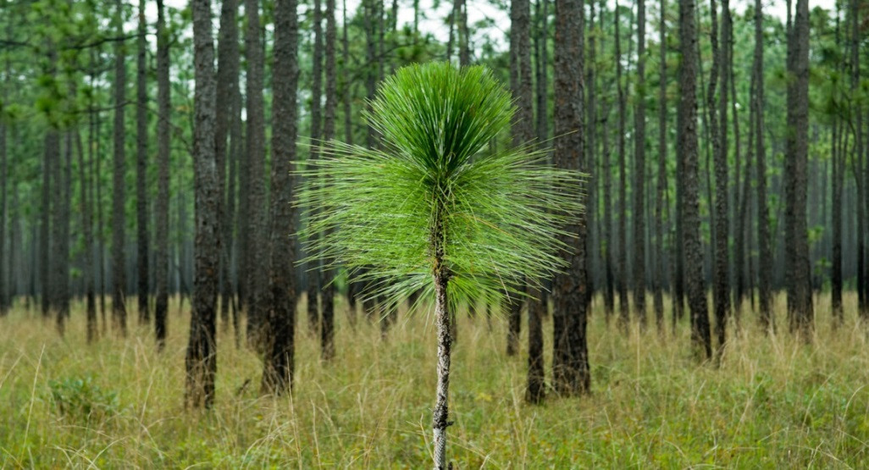
Afforestation
Afforestation involves planting tree seedlings on sites that have been without trees for several years, generally a decade or more. The primary climate change benefit of afforestation discussed in scientific and policy literature is carbon sequestration. It is regarded as a prime carbon sequestration strategy because forest communities can store about 10 times more carbon in their vegetation than non-forest communities and for longer time periods (decades to hundreds of years).
Other benefits include erosion control, recreational value, wildlife habitat, and production of forest goods. On a large scale, afforestation can modify local climates by increasing humidity.
Water
Supply
Restoration
Project
CLICK HERE

Slide 20
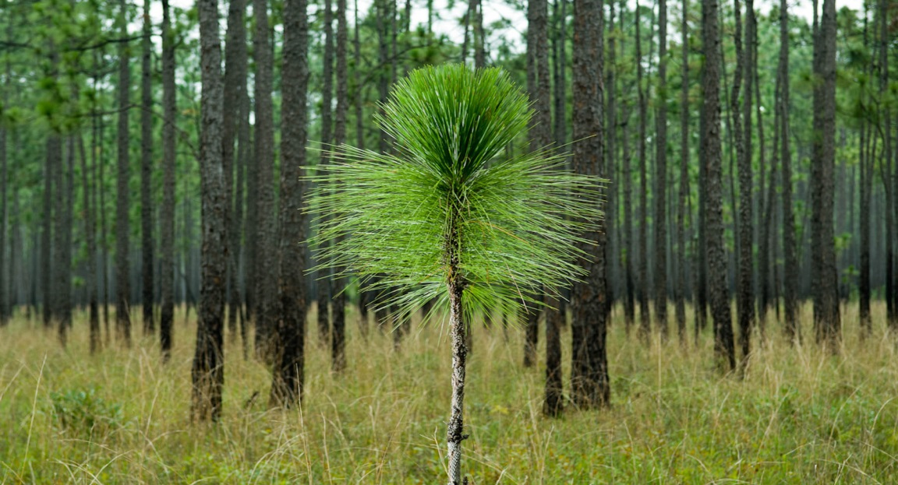
The planting of trees is well known and well practiced; afforestation is an accepted project activity under the Clean Development Mechanism (CDM) of the Kyoto Protocol.
Certain models estimate that a total of 60 million to 65 million acres of U.S. agricultural land could be converted to woodlands by 2050, including 35 million to 50 million acres of cropland.
The cost of an afforestation project can range from approximately $65 to $200 per acre due in part to the previous land use of the site and the terrain.
Water
Supply
Restoration
Project
CLICK HERE

Slide 21
Enhanced Weathering
Carbon dioxide is naturally removed from the atmosphere slowly through weathering (or
disintegration) of silicate and carbonate rocks.
Expediting the weathering process—enhanced weathering—could remove large amounts of CO2 from the atmosphere.
The disintegrated materials containing CO2 removed from an enhanced weathering project could be stored in the deep ocean or in soils.
One proposed method is to spread crushed olivine, a type of silicate rock, on agricultural and forested lands to sequester CO2 and improve soil quality.
This technique would require large amounts of rocks to be mined, ground, and transported.
The lifecycle carbon benefit has not been calculated. Significant amounts of additional resources, such as energy and water, may be required to conduct an enhanced weathering project.

Slide 22
Solar Radiation Management (SRM)
Solar radiation management methods work to reduce or divert the amount of incoming solar radiation by making the Earth more reflective (i.e., enhancing albedo) and do not have any effect on GHG emission rates.
SRM methods involve modifying albedo via land-based methods such as desert reflectors, cloud-based methods such as cloud whitening, stratosphere-based methods such as aerosol injection, and spaced-based methods such as shields.
The effectiveness of an SRM method depends on its geographical location, the altitude at which it is applied (surface, atmosphere, space), and the radiative properties of the atmosphere and surface.
SRM methods could be deployed faster than CDR methods should the need arise to cool the planet quickly. SRM methods have been described, theoretically, as cheap, fast, and imperfect.

Slide 23
Solar Radiation Management and Significant Environmental Risks
• System failure. If an SRM technique breaks down or is shut down, the climate may warm very quickly, possibly leaving little time for humans and nature to adapt.
• Changes in regional and seasonal climates. SRM techniques may alter precipitation patterns, which could have consequences for ecosystems and affected societies.
• Ozone depletion. Under certain circumstances, use of SRM techniques such as sulfate aerosol injection may lead to ozone depletion which would allow harmful UVB rays to reach the Earth.
• Preservation of non-CO2 greenhouse gases. SRM techniques applied in the stratosphere or space lessen the amount of ultraviolet radiation striking the Earth’s atmosphere, which is likely to extend the atmospheric lifetime of non- CO2 greenhouse gases that are more potent than CO2.
• Diversion from more permanent solutions. If societies conclude that SRM techniques can provide quick relief, they may invest less in developing and deploying more permanent GHG emission reduction solutions.
• “Unknown unknowns.” The history of the Earth’s climate demonstrates that small changes may result in abrupt changes, raising concerns about unknown effects of large-scale geoengineering.

Slide 24
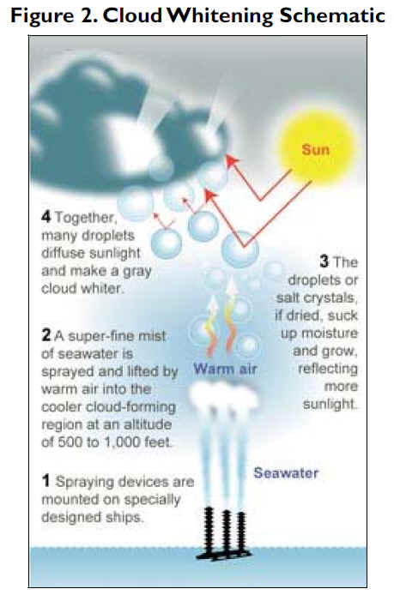
Enhanced Albedo (Surface and Cloud)
Applying enhanced albedo methods in urban areas such as painting roofs and paved areas white on a global basis is estimated to cost several billion dollars for materials and labor, but could save money on energy costs.
Genetically modified plants to increase albedo and reflect sunlight.
Cloud whitening with dispersion of cloud-condensation nuclei (e.g., small particles of sea salt) in clouds in desired areas on a continual basis, Aircraft, drones, ships, or unmanned, radio-controlled seacraft could disperse the nuclei.
Depending on the scale of the project, marine ecosystems could be disturbed. Further research is needed for spray generator development, and to assess potential impacts on ocean currents and precipitation patterns.

Slide 25
Aerosol Injection (SAG) (Stratospheric Aerosol Geoengineering)
The technology calls for dispersal of aerosols, such as hydrogen sulfide (H2S) or sulfur dioxide (SO2), into the stratosphere to direct solar radiation back toward space or absorb heat, thus cooling the Earth.
Aircraft, artillery shells, or stratospheric balloons could be employed to inject the aerosols.
The annual cost for sulfur particle injection using airplanes is calculated to be several billion dollars, depending on the amount, location, and type of sulfur particle injected into the stratosphere. However, there has not been any testing to determine whether the theoretical predictions will match reality.
Aerosol injection seeks to imitate large volcanic eruptions. Indeed, many studies have based aerosol injection simulations on data gathered and analyzed from the Mount Pinatubo volcanic eruption in the Philippines in 1991, which led to a reduction in global temperatures, though not distributed evenly across regions.

Slide 26
Space-Based Reflectors
A theoretical geoengineering technology proposal to position shields in space to reduce the amount of incoming solar radiation. The effectiveness of the shield would vary based on its design, material, location, quantity, and maintenance. Suggested materials are lunar glass, aluminum thread netting, metallic reflecting disks, and refracting disks. Proposed shield locations include the low Earth orbit and Lagrange point.
Further research is needed to assess shield costs; appropriate steps for implementation, including transportation to the desired location; maintenance needs; shield disposal; and ecological impacts.
Would reflectors be deployed to alter the climate at a global or regional level?
Is the science behind reflector deployment mature enough to provide guidance on where shield protection would be most needed?
It may take several decades to construct and deploy a shield. Should the shield fail or be removed, warmer temperatures would ensue rapidly if CO2 emission rates continued to rise. One study suggests that launching a shield to fully reverse global warming may cost a few trillion dollars, implemented over a 25-year time

Slide 27
Debate Over Methods of Oversight
Modest funding for geoengineering research, the limited regulation of particular geoengineering activities, and a lack of a comprehensive system of oversight or technology promotion.
Advocates of maintaining this status quo tend to see private industry and commercial development as the best avenue through which to determine the merits of GE research and entrepreneurship and/or to pursue it.
Greater government intervention in GE research and development may stifle fact gathering and agenda setting, incorrectly choose winners and losers, and unnecessarily circumscribe a science still in its infancy.
If governments opt to address GE activities without engaging in new law or treaty making, they would essentially endorse the status quo.

Slide 28
Threshold For Oversight:
If policymakers decide to address geoengineering more aggressively or comprehensively, one possible policy proposal will entail creating a system for government oversight of both research and deployment of geoengineering technologies.
Suggestions for criteria for determining the point at which geoengineering activities should become subject to a larger system of oversight or regulation. These criteria include:
• the extent to which the impacts of geoengineering are transboundary or
international in scope;
• the extent to which the impacts of geoengineering include the introduction of
hazardous material into the environment;
• the potential perturbation, reversibility, and duration of the geoengineering
activity under discussion.

Slide 29
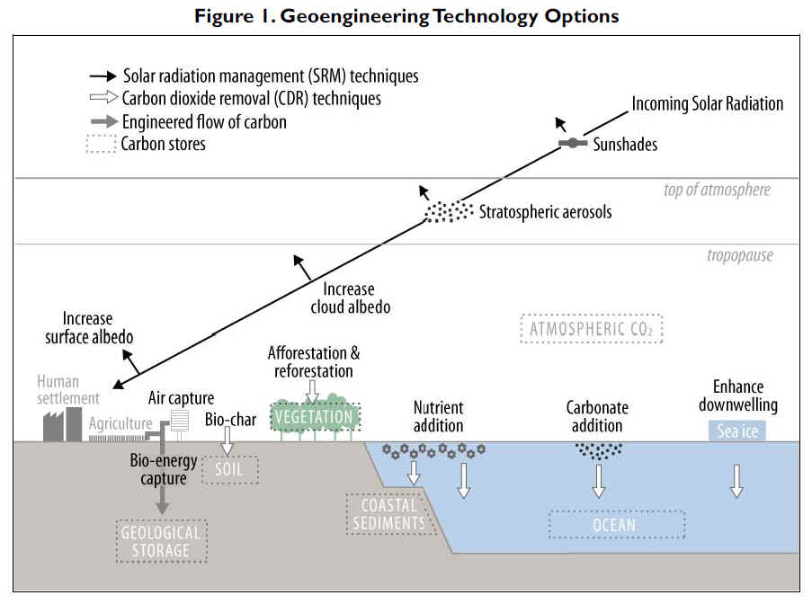

Slide 30
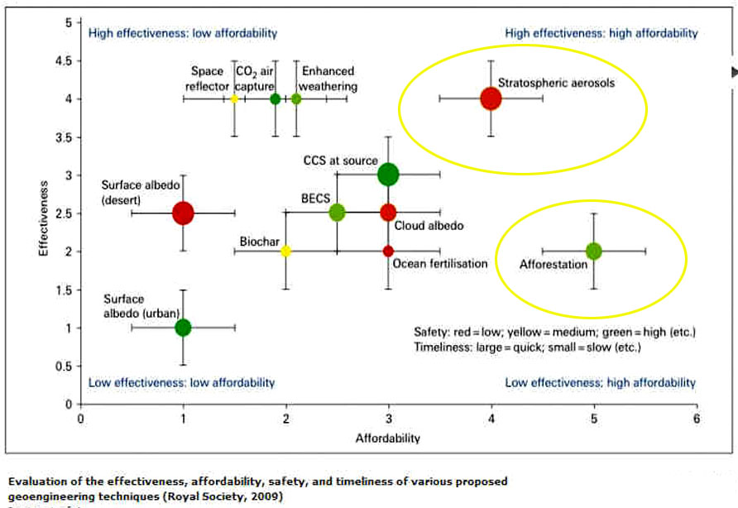

Slide 31
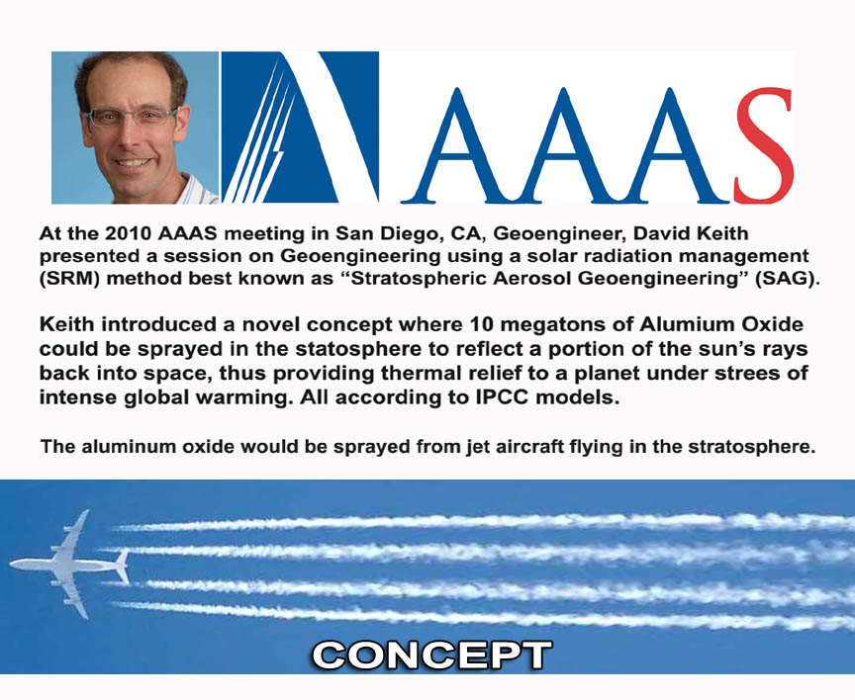


Slide 32
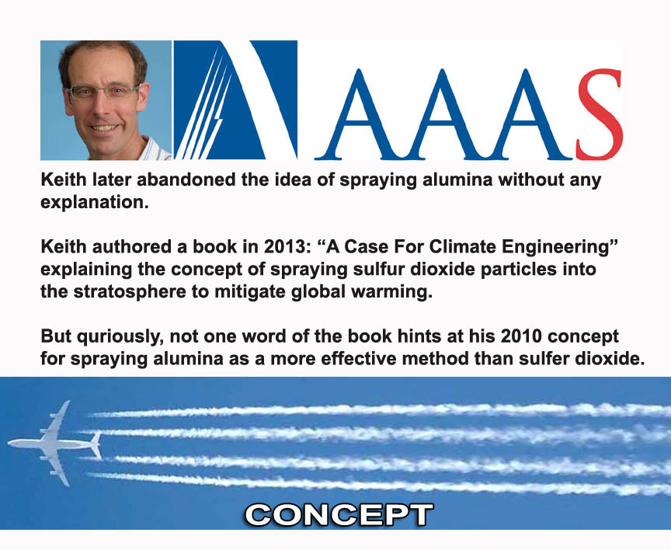

Slide 33

David W. Keith is a Canadian environmental scientist and a Gordon McKay Professor of Applied Physics, School of Engineering and Applied Sciences (SEAS) and Professor of Public Policy, Harvard Kennedy School, Harvard University and president of Carbon Engineering, based in Calgary.
His company, Carbon Engineering works on ways to capture carbon dioxide directly from the atmosphere.
In 2013, Keith released a book, A Case for Climate Engineering, detailing a controversial strategy for slowing climate change making a case for spraying additional sulfate or sulfuric acid aerosols in the upper atmosphere to create a reflective shield that would slow down the rate of climate change and buy humans time to curb emissions and instill more sustainable behavior. He estimates the cost at $1 billion per year.

Slide 34
Keith predicts that, without action, climate change would cost at least $1 trillion a year by 2050.
Keith has been featured on the Discovery Channel, interviewed on BBC News HARD Talk in November 2011, and has participated in TED talks in September 2007 .
He also promoted his geoengineering idea to slow climate change by spraying reflective particles into the upper atmosphere on The Colbert Report.
Source Wikipedia – CLICK HERE

Slide 35
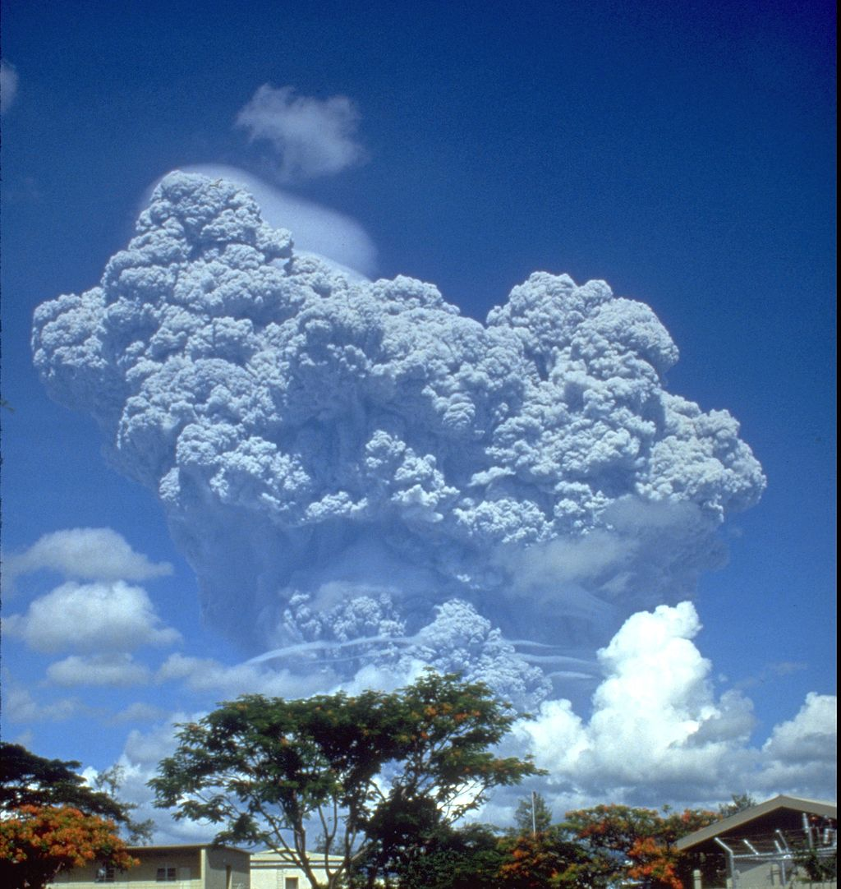
The concept to release sulfuric acid aerosols high in the atmosphere to reflect sunlight is inspired from the measurements of global cooling following the eruption of Mt. Pinatubo in the Philippines in 1991. (James Hansen et al)
Stratospheric Aerosol Geoengineering (SAG) is expected to mimic the Mt. Pinatubo effect by cooling surface temperatures.

Slide 36
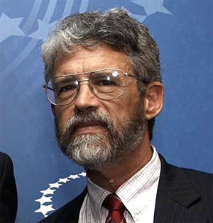
John Holdron, Obama Science Advisor: "My personal opinion is that we have to keep Geoengineering on the table. We have to look at it very carefully because we might get desperate enough to want to use it."
Holdron acknowledges the risk of "side effects that are worse than the dimension of the problem you're trying to cure".

Slide 37

Colbert Report with David Keith Video – CLICK HERE

Slide 39
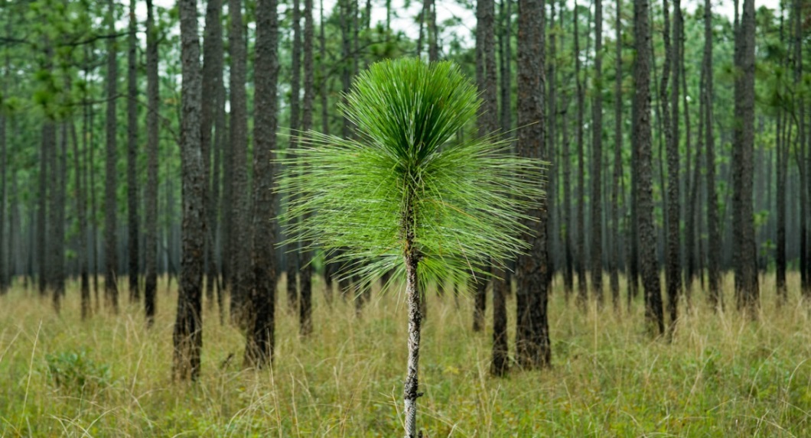
Afforestation
Afforestation involves planting tree seedlings on sites that have been without trees for several years, generally a decade or more. The primary climate change benefit of afforestation discussed in scientific and policy literature is carbon sequestration. It is regarded as a prime carbon sequestration strategy because forest communities can store about 10 times more carbon in their vegetation than non-forest communities and for longer time periods (decades to hundreds of years).
Other benefits include erosion control, recreational value, wildlife habitat, and production of forest goods. On a large scale, afforestation can modify local climates by increasing humidity.
Water
Supply
Restoration
Project
CLICK HERE

Slide 40
The planting of trees is well known and well practiced; afforestation is an accepted project activity under the Clean Development Mechanism (CDM) of the Kyoto Protocol.
Certain models estimate that a total of 60 million to 65 million acres of U.S. agricultural land could be converted to woodlands by 2050, including 35 million to 50 million acres of cropland.
The cost of an afforestation project can range from approximately $65 to $200 per acre due in part to the previous land use of the site and the terrain.
Water
Supply
Restoration
Project
CLICK HERE

Slide 41
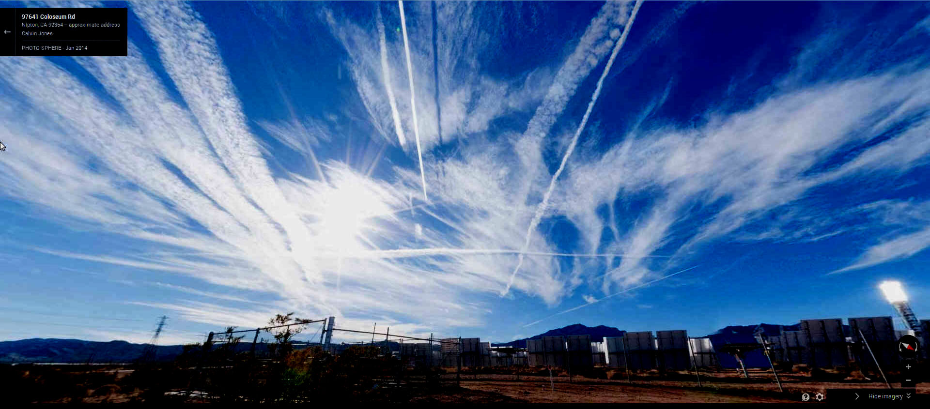
Many observers are convinced that geoengineering the skies is already underway. -- These jet trails over Dry Lake, CA are not likely to be normal water vapor since the atmosphere at flight level above 30,000 feet is less than 30% relative humidity and incapable of forming persistent contrails of normal water vapor.
The planting of trees is well known and well practiced; afforestation is an accepted project
activity under the Clean Development Mechanism (CDM) of the Kyoto Protocol.
Certain models estimate that a total of 60 million to 65 million acres of U.S. agricultural land could be converted to woodlands by 2050, including 35 million to 50 million acres of cropland.
The cost of an afforestation project can range from approximately $65 to $200 per acre due in part to the previous land use of the site and the terrain.
Water
Supply
Restoration
Project
CLICK HERE

Slide 42
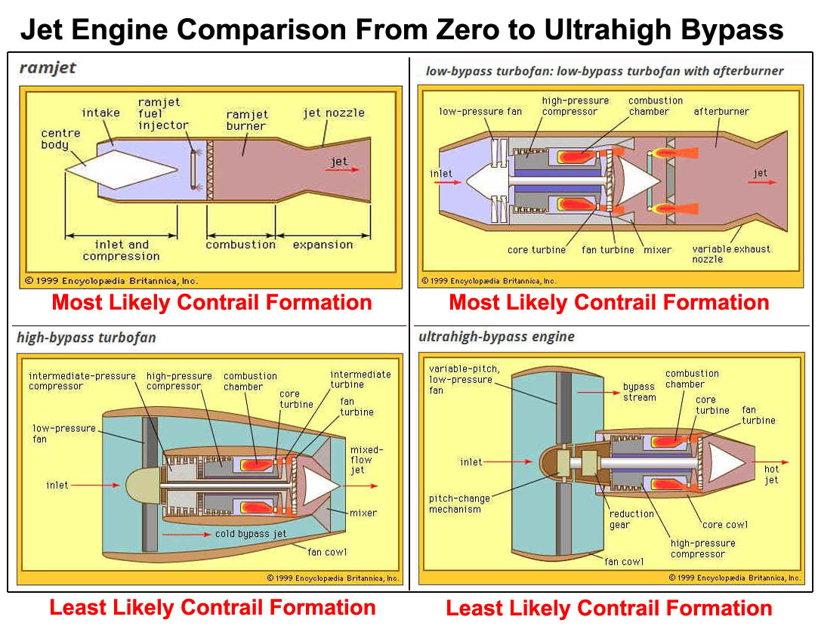
The planting of trees is well known and well practiced; afforestation is an accepted project
activity under the Clean Development Mechanism (CDM) of the Kyoto Protocol.
Certain models estimate that a total of 60 million to 65 million acres of U.S. agricultural land could be converted to woodlands by 2050, including 35 million to 50 million acres of cropland.
The cost of an afforestation project can range from approximately $65 to $200 per acre due in part to the previous land use of the site and the terrain.
Water
Supply
Restoration
Project
CLICK HERE

Slide 43
The main products of hydrocarbon fuel combustion are carbon dioxide and water vapor.
In older designs of Ramjet and “low-bypass” jet engines, contrails were readily formed at altitudes above 28,000 feet when water vapor (produced by fuel combustion) temporarily raised the relative humidity of the atmosphere outside the aircraft.
Water vapor, blown out the engine exhaust would form a visible contrail of ice crystals as it cooled at a distance of approximately one and one-half wing-spans behind the engine.
Tiny particulates of sulfur in the jet exhaust would allow the super-cooled water to crystallize into the familiar jet contrail formation that routinely dissipated within a few seconds behind the aircraft.
The planting of trees is well known and well practiced; afforestation is an accepted project
activity under the Clean Development Mechanism (CDM) of the Kyoto Protocol.
Certain models estimate that a total of 60 million to 65 million acres of U.S. agricultural land could be converted to woodlands by 2050, including 35 million to 50 million acres of cropland.
The cost of an afforestation project can range from approximately $65 to $200 per acre due in part to the previous land use of the site and the terrain.
Water
Supply
Restoration
Project
CLICK HERE

Slide 44
High Bypass Jet engines less likely to produce contrails:
The term “high bypass” refers to the high ratio of thrust produced by air that is not subjected directly to hydrocarbon fuel combustion necessary to form a contrail.
Since 80% of the air providing thrust bypasses direct combustion it is not capable of producing the water vapor required to form ice crystals as a visible contrail.
Furthermore, the mixing of 20% combusted and 80% non-combusted bypass thrust dilutes the combined thrust as it exits the engine. This mixing of water vapor from the 20% combustion with the 80% non-combusted thrust effectively dilutes the ability of water vapor to impact the atmosphere outside the aircraft to produce a visible contrail – much less, a persistent contrail requiring near saturated relative humidity at flight level.
The planting of trees is well known and well practiced; afforestation is an accepted project
activity under the Clean Development Mechanism (CDM) of the Kyoto Protocol.
Certain models estimate that a total of 60 million to 65 million acres of U.S. agricultural land could be converted to woodlands by 2050, including 35 million to 50 million acres of cropland.
The cost of an afforestation project can range from approximately $65 to $200 per acre due in part to the previous land use of the site and the terrain.
Water
Supply
Restoration
Project
CLICK HERE

Slide 45
The purpose of this presentation is to review current Geoengineering and Global Warming mitigation policies and technologies to determine how this issue could limit or enhance the option of Alachua County, Gainesville and local governments to exercise local control, future land use, water resources and/or environmental protection.
Who Will Chose “Winners and Losers” in Geoengineering?
Geoengineering technologies can reduce rainfall and interfere with solar panel energy efficiency
"Greater government intervention in geoengineering research and development may stifle fact gathering and agenda setting, incorrectly choose winners and losers, and unnecessarily circumscribe a science still in its infancy. – Page 20

